Slide 1
Predicting Which Recommended Content Users Click
DS-SEA-07
Pramod Varma

Slide 2
What is the challenge?
Can we predict which recommended content each user will click?
What are the significant features that drive the likely hood of user clicking the recommended content indicating association?
Improving Outbrain’s recommendation algorithm will mean more users uncover stories that satisfy their individual tastes.
Notes:
Problem Definition
: Given some
webpage and ad information, determine
which ad is more likely to be clicked on
the given webpage
Input
: Sparse information related to each
webpage, the ads on the webpage
•
Output
: Which ad is clicked of a set of
ads that user is reading

Slide 3
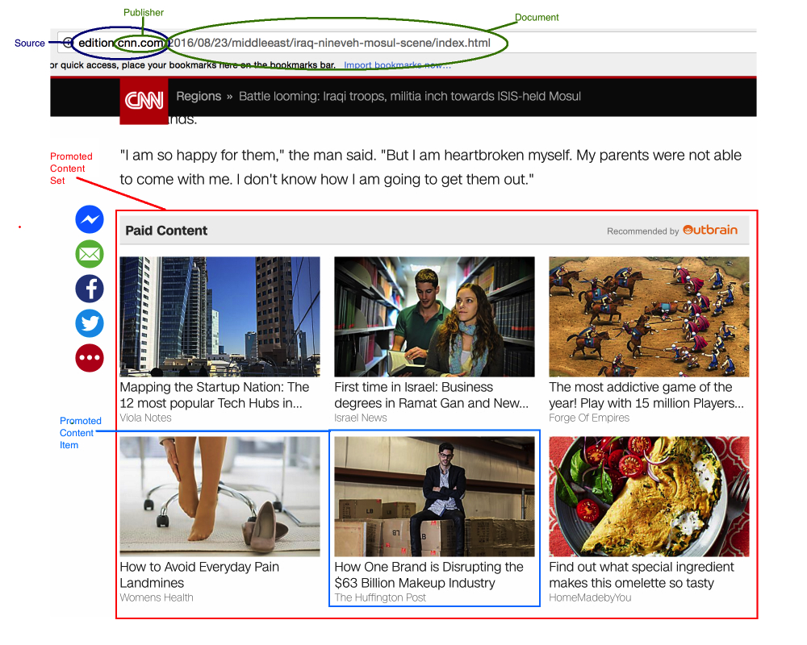
DATA – Sample Page?

Slide 4
What data would be used ?
Outbrain's two weeks of data from 14-Jun-2016 and 28-jun-2016 provided on kaggle.
This is a very large relational set where one of the log file is ( 2B rows and 100GB uncompressed).
2 Billion page views and 16,900,000 clicks of 700 Million unique users, across 560 sites.
Link to acquire the data: https://www.kaggle.com/c/outbrain-click-prediction/data.
Notes:
If the large amount of data is unmanageable the data size may be reduced 1/10th so the project could be completed in the given timeframe.

Slide 5
Data – BiG or Small ?
Collected Data from multiple CSV files
Database Size - ~9.7GB
Did not even load the entire PAGE_VIEW log!!
table | table_size | related_objects_size | total_table_size | live_rows
----------------------+------------+----------------------+------------------+-----------
promoted_content | 32 MB | 32 kB | 32 MB | 559583
documents_meta | 164 MB | 64 kB | 164 MB | 2999334
documents_categories | 273 MB | 88 kB | 273 MB | 5481471
documents_entities | 446 MB | 136 kB | 446 MB | 5537633
page_views_sample | 726 MB | 200 kB | 726 MB | 10000008
documents_topics | 564 MB | 160 kB | 564 MB | 11325980
events | 1822 MB | 480 kB | 1822 MB | 23121858
clicks_test | 1361 MB | 360 kB | 1361 MB | 32225335
clicks_train | 4336 MB | 1112 kB | 4337 MB | 87141751
TOTAL | 9724 MB | 2632 kB | 9726 MB | 178392953
Notes:
Outbrain provided total of eight datasets as described below:
1) page_views: Describes features of all viewed pages, regardless of an advertisement being clicked.
2) events: Consists of features of pages viewed when one displayed advertisement was clicked.
3) promoted content: provides information on advertised content.
4) clicks_train/clicks_test: provides examples with labels to be used for training and examples without labels to be used for testing.
5) documents_meta: describes documents’ metadata.
6) documents_entities, 7) documents_topic, and 8) documents_categories: provide mentioned entities (person, place, or location), topic, and taxonomy of categories of the documents, respectively.

Slide 6
Data – Pre-Processing and Feature Selection
Data provided were normalized table
Created a relational database locally for each data set
Hand picked selected features based on cardinality of the data set
Developed Intermediate tables to extract key features
Create a de-normalized fact table to get selected the features
Create Feature and Response vector

Slide 7
EDA - Findings
Clicks_train and Test
Number of Ads Vs proportion of set
Train VS Test distribution
Number of times an ad appeared
Events
Platforms
Missing values
Document Meta
Python Note book: https://github.com/Pramodv79/DSClickPrediction/blob/master/notebooks/EDA_OutbrainRawDataset.ipynb

Slide 8
Feature - Selection
Dataset | Column | Cardinality | Missing | %Missing | Total Rows
clicks_train | display_id | 16,874,593 | 0 | 0.00000 | 87,141,731
clicks_train | ad_id | 478,950 | 0 | 0.00000 | 87,141,731
clicks_train | clicked | 2 | 0 | 0.00000 | 87,141,731
events | platform | 4 | 0 | 0.00000 | 23,120,126
events | display_id | 23,120,126 | 0 | 0.00000 | 23,120,126
events | document_id | 894,060 | 0 | 0.00000 | 23,120,126
events | uuid | 19,794,967 | 0 | 0.00000 | 23,120,126
events | geo_location | 2,989 | 340 | 0.00001 | 23,120,126
events | timestamp | 22,896,622 | 0 | 0.00000 | 23,120,126
document_meta | document_id |  |  |  | 2,999,334
document_meta | source_id | 14,395 | 2,518 | 0.00084 | 2,999,334
document_meta | publisher_id | 1,260 | 64,024 | 0.02135 | 2,999,334
document_meta | publish_time | 49,914 | 1,011,118 | 0.33711 | 2,999,334
document_topics | document_id | 2,495,423 | 0 | 0.00000 | 11,325,960
document_topics | topic_id | 300 | 0 | 0.00000 | 11,325,960
document_topics | confidence_level | 10,124,758 | 0 | 0.00000 | 11,325,960
documents_categories | document_id | 2,828,649 | 0 | 0.00000 | 5,481,475
documents_categories | category_id | 97 | 0 | 0.00000 | 5,481,475
documents_categories | confidence_level | 21,900 | 0 | 0.00000 | 5,481,475
documents_entities | document_id | 1,791,420 | 0 | 0.00000 | 5,537,552
documents_entities | entity_id | 1,326,009 | 0 | 0.00000 | 5,537,552
documents_entities | confidence_level | 2,678,533 | 0 | 0.00000 | 5,537,552
promoted_content | document_id | 185,709 | 0 | 0.00000 | 559,583
promoted_content | ad_id | 559,583 | 0 | 0.00000 | 559,583
promoted_content | campaign_id | 34,675 | 0 | 0.00000 | 559,583
promoted_content | advertiser_id | 4,385 | 0 | 0.00000 | 559,583

Slide 9
Re-Scoping of the Project
Compute and Time Constrain
Reduced the scope
Did not use PAGE_VIEWS ( 2B -> 87 M)
Did not use time series modeling
Reduced the training set to a sample of 1M Events
Used Meta data with highest confidence
Did not rank order ads for a given set only. Only performed binary classification

Slide 10
Model Selection
Used two models to compare the performance ( AUC and Accuracy )
Random Forest
Linear Model

Slide 11
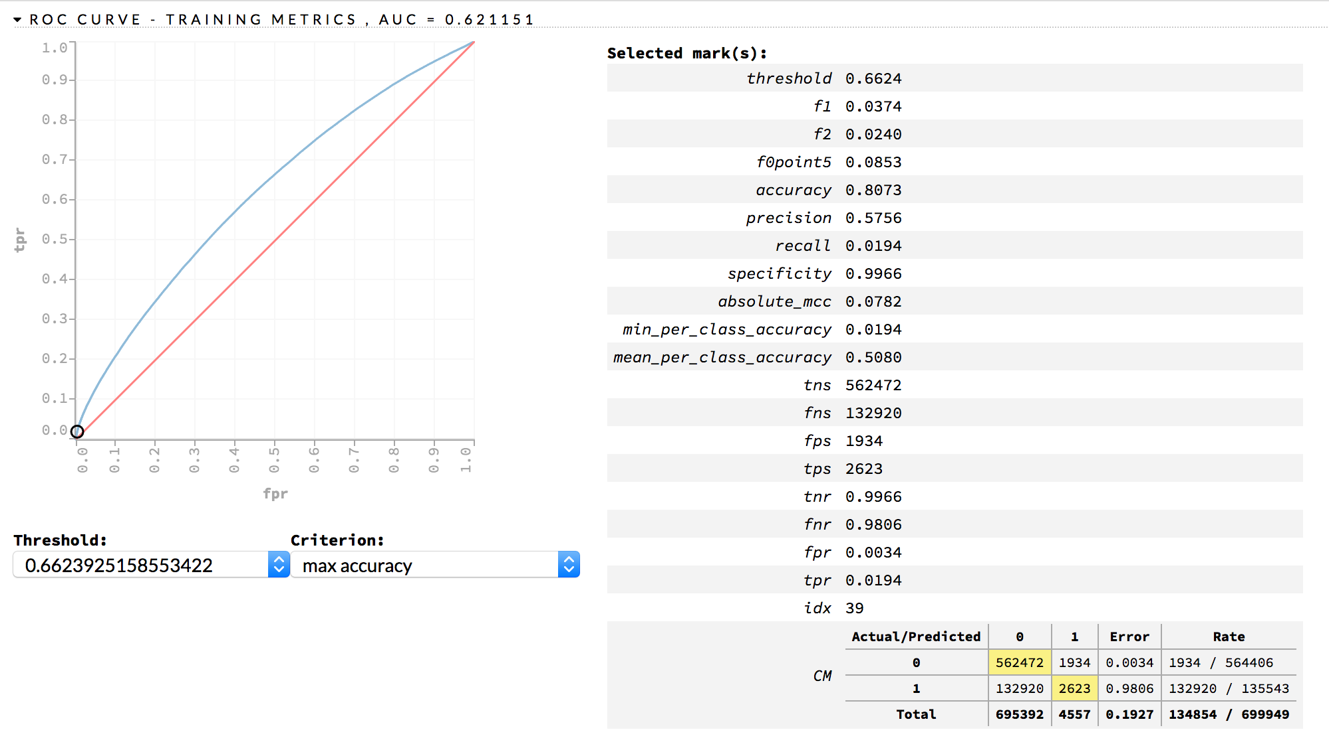
RANDOM FOREST - TRaining

Slide 12
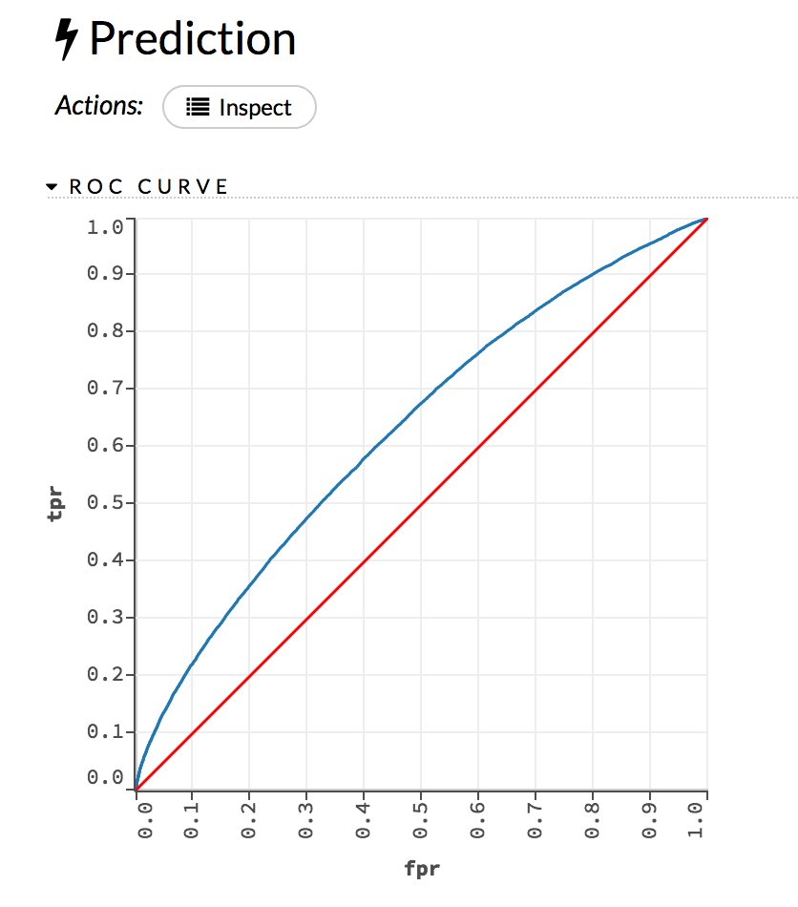
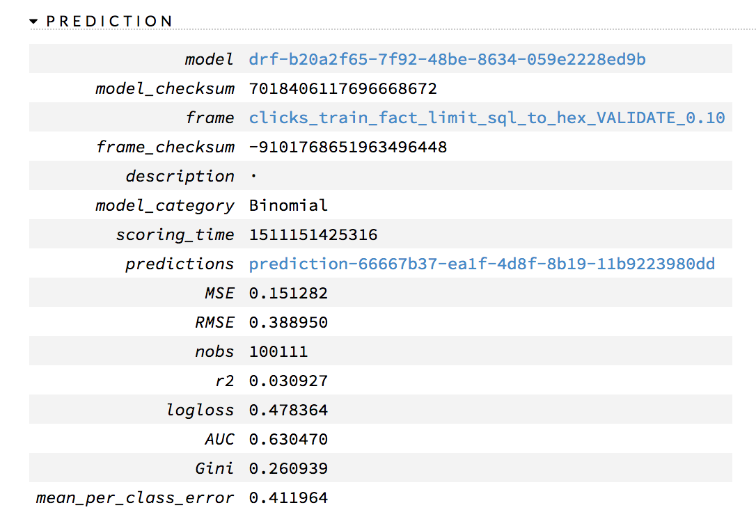
Random Forest - Prediction

Slide 13
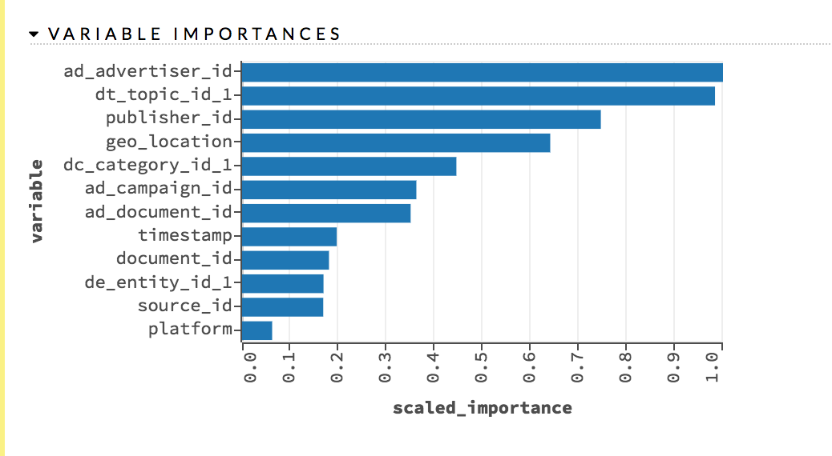
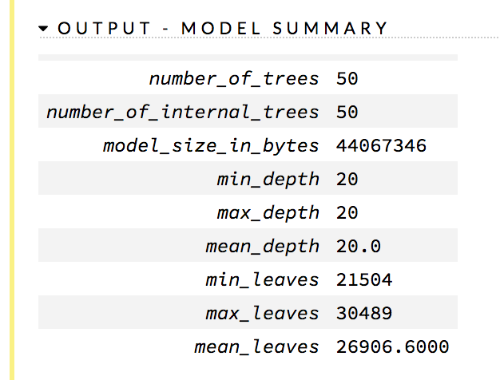
Random Forest – Variable Importance & Model Summary

Slide 14
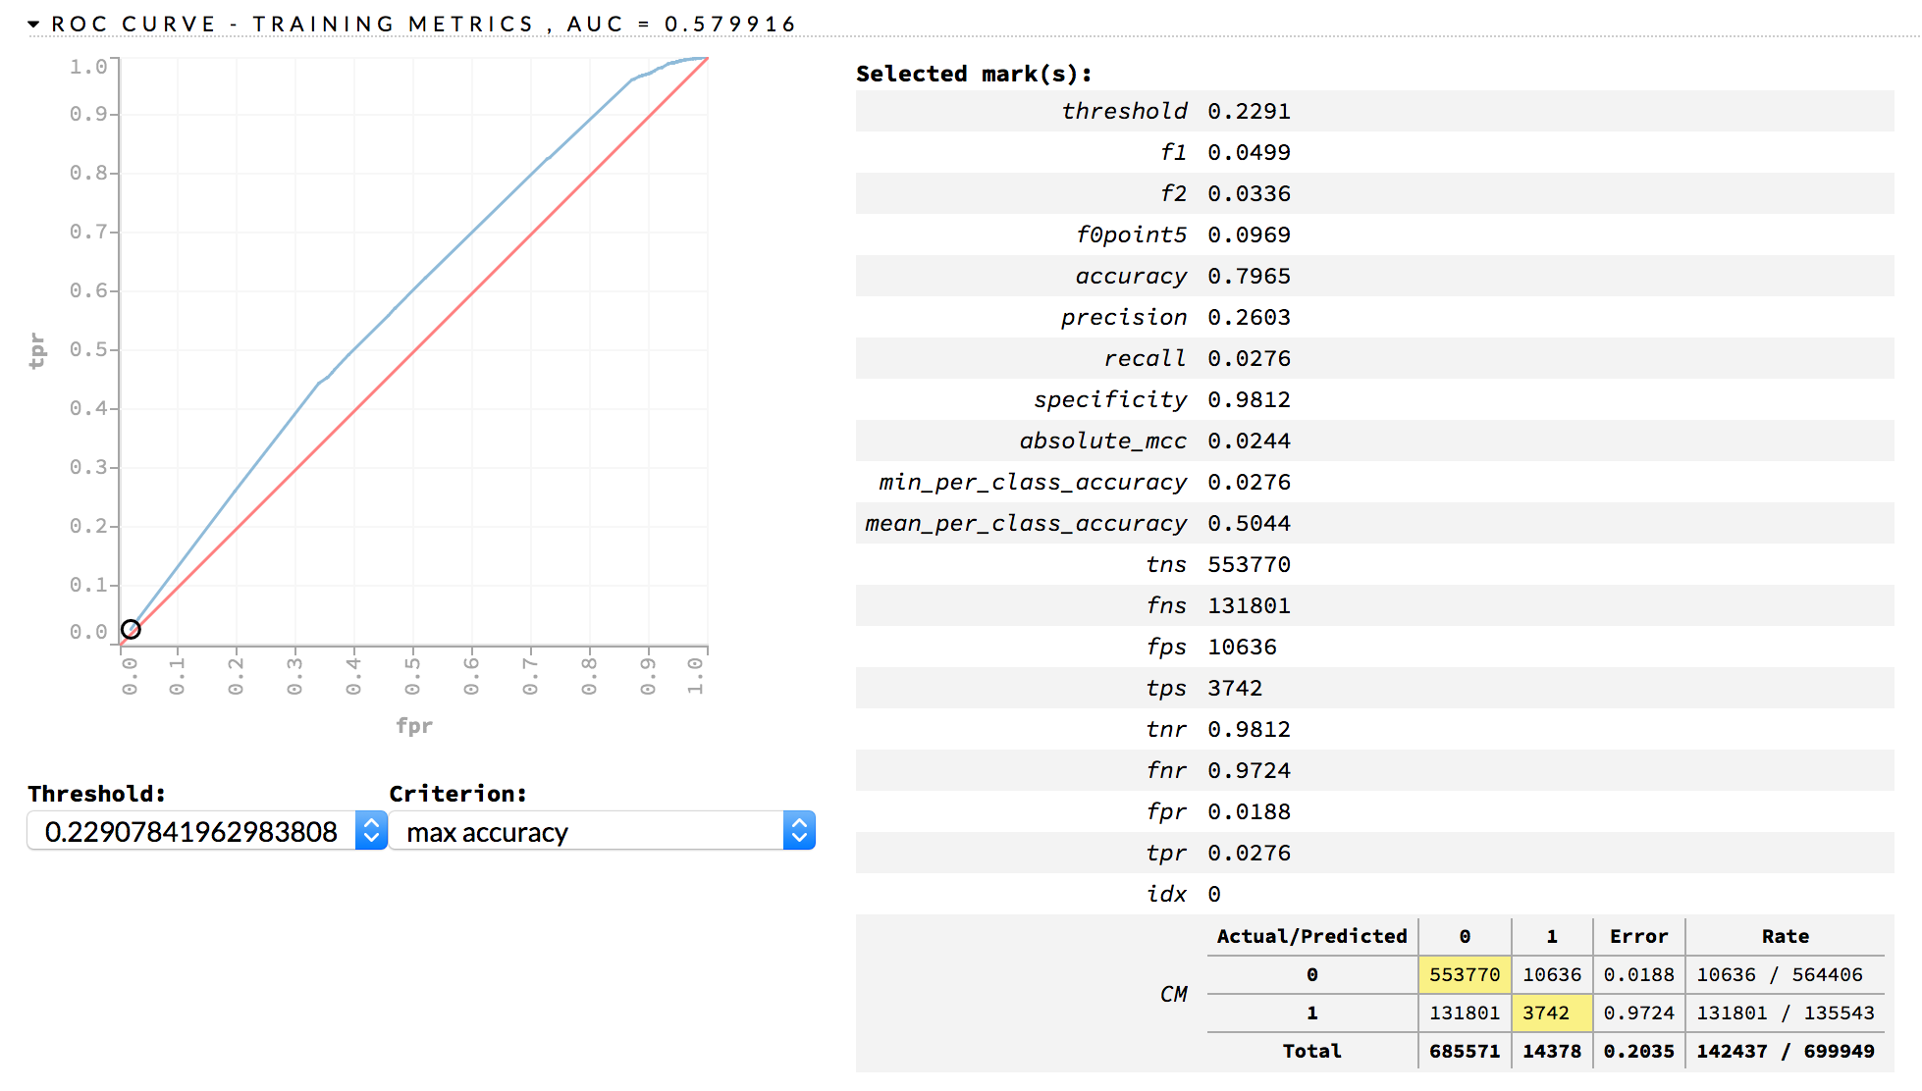
Generalized Linear Model ( GLM) - Training

Slide 15
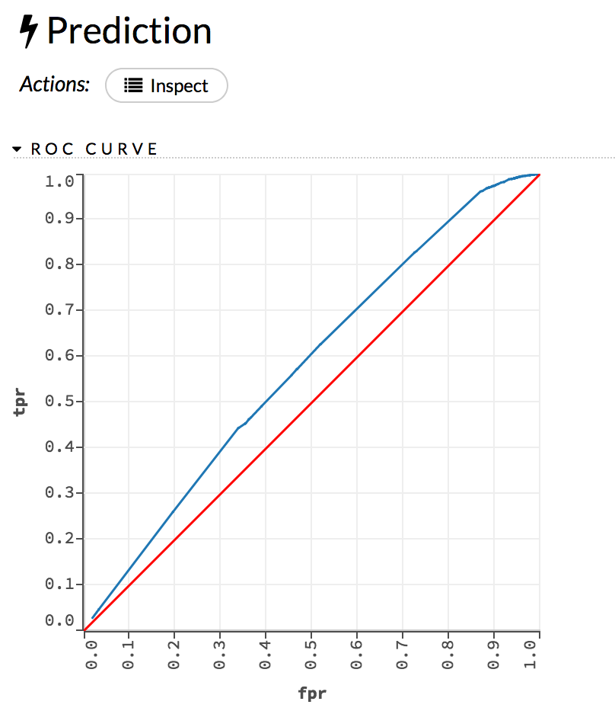
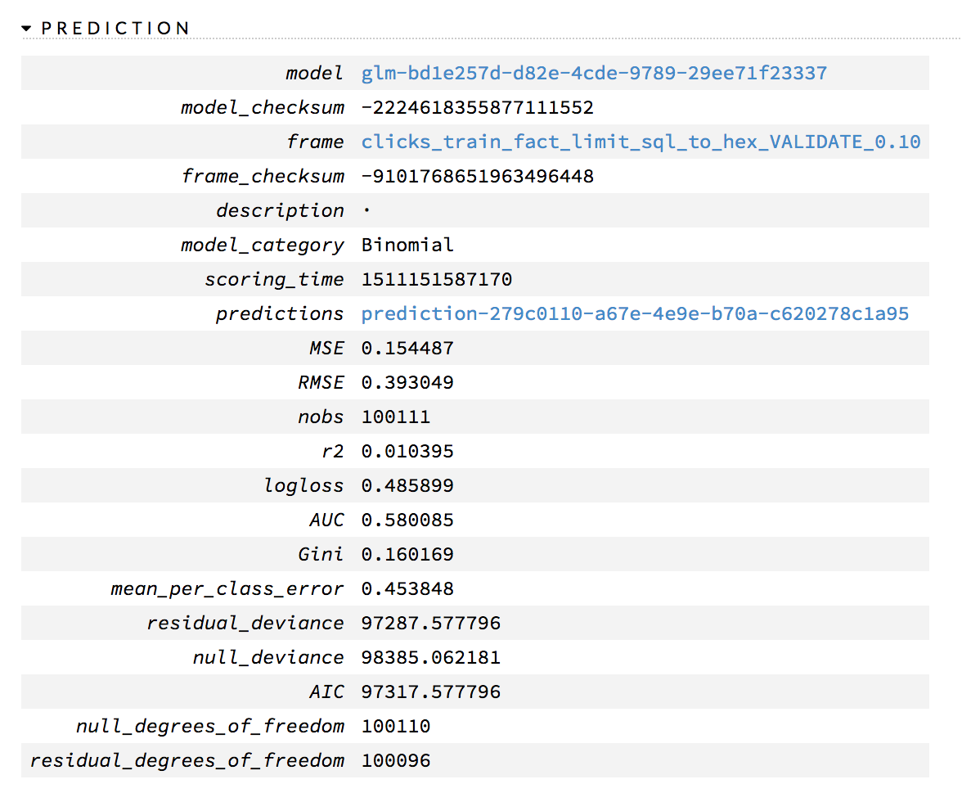
GLM - Prediction

Slide 16
Challenges and Success stories
Challenges
Size of the data
Categorical Features
Compute Resources
Success Stories
Multiple tools ( SQL, Python, H2O )

Slide 17
Future Work
Tune Random Forest further for depth, number of trees and features selected
Add additional features to improve accuracy
Pick top 3 topics, categories and entities by confidence level instead of one
Enrich document ID features for the Ad
Cluster high cardinality features into low cardinality features ( eg. DB scan )
Use other machine learning models to improve accuracy (e.g. XGBoost)
Move to cloud to run on a larger training set and see if page_views would be beneficial
Notes:
Due to reduced time for the submission, I was able to only develop only one model for random forest and linear model. As part of future work it will be beneficial to do following

Slide 18
Questions ?

Slide 19
Reference
[1] https://www.kaggle.com/c/outbrain-click-prediction/data
[2] Python notebook: https://github.com/Pramodv79/DSClickPrediction/blob/master/notebooks/EDA_OutbrainRawDataset.ipynb
[3] Text file with SQL Commands to create FACT table for model building: https://github.com/Pramodv79/DSClickPrediction/blob/master/database/SQL_CREATE_CLEAN_TABLES
[4] Python notebook used to load the dataset into H2O: https://github.com/Pramodv79/DSClickPrediction/blob/master/notebooks/EDA_OutbrainLoadDataIntoH20Frame.ipynb
[5] H20 notebook used to train, validate and predict Random Forest and GLM model: [ insert link to H20 flow notebook]

Slide 20
APPENDIX – II ; Graphical Representation of the data
Raw Data
Document_id
Ad_id
Document
AD
Topic
Category
Source
Advertiser
Campaign
Notes:
Features
Topic id: Topic of webpage
Category id: Category of
webpage
Source id: source that webpage is from
Advertiser id: Advertiser of ad
Campaign id: Campaign of ad

